Slide 1
BRAIN STROKE PREDICTION
-Presented by,
Latheesh Vijo

Slide 2
INTRODUCTION
The primary objective of this project is to develop a robust and accurate predictive model for stroke, utilizing advanced machine learning techniques. By identifying individuals at high risk, the model aims to aid healthcare professionals in implementing timely interventions, ultimately reducing the incidence and impact of strokes.

Slide 3
Here are the column details for your healthcare dataset related to stroke data:
id: int64 - Unique identifier for each patient
gender: object - Gender of the patient (e.g., Male, Female, Other).
age: float64 - Age of the patient.
hypertension: int64 - Whether the patient has hypertension (0: No, 1: Yes).
heart_disease: int64 - Whether the patient has heart disease (0: No, 1: Yes).
ever_married: object - Whether the patient has ever been married (e.g., Yes, No).
work_type: object - Type of work the patient does (e.g., Private, Self-employed, Govt_job).
Residence_type: object - Type of residence the patient lives in (e.g., Urban, Rural).

Slide 4
9.Avg_glucose_level: float64 - Average glucose level in the blood.
10.bmi: float64 - Body Mass Index of the patient.
11.smoking_status: object - Smoking status of the patient (e.g., formerly smoked, never smoked,
smokes).
12.stroke: int64 - Whether the patient had a stroke (0: No, 1: Yes).

Slide 5
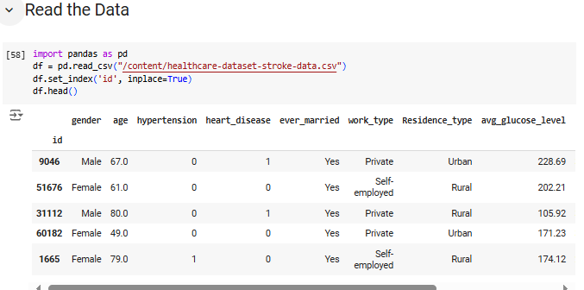

Slide 6
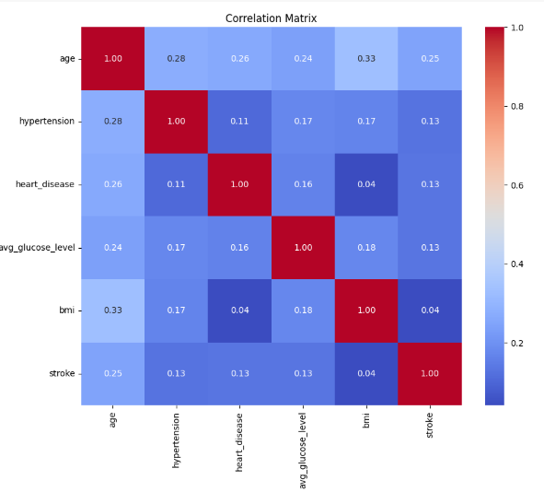
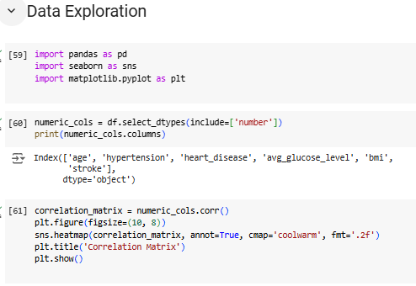

Slide 7
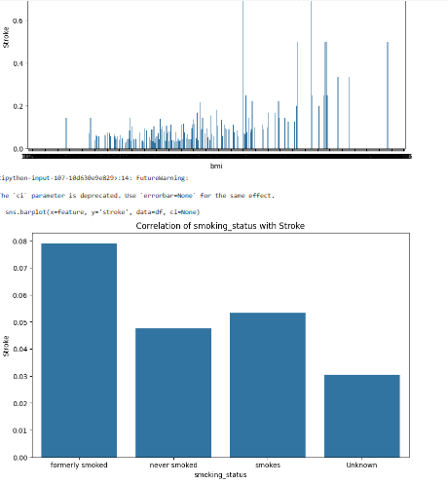
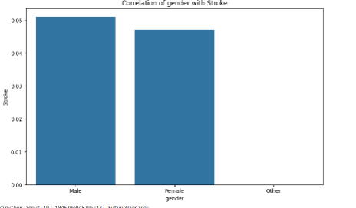
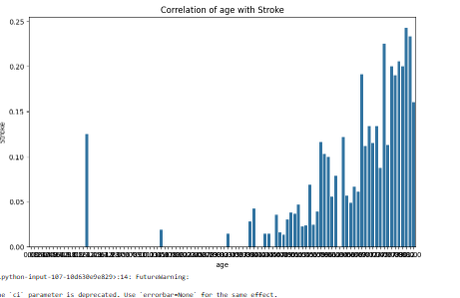

Slide 8
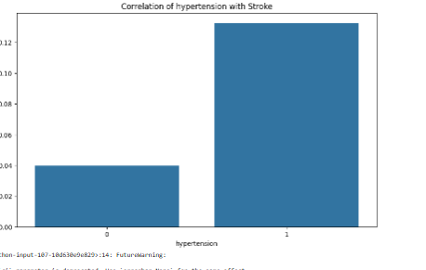
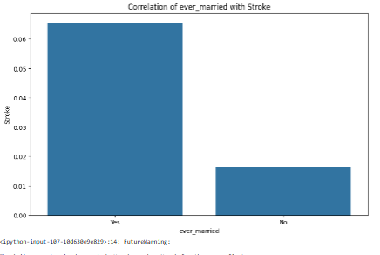
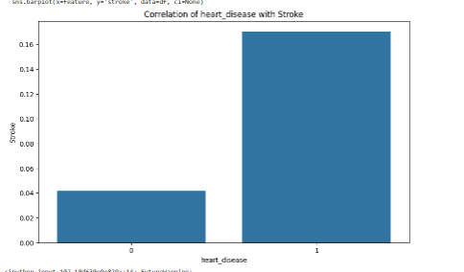
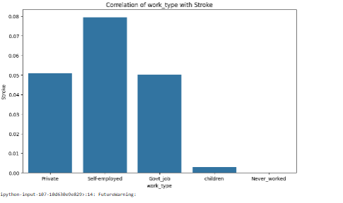

Slide 9
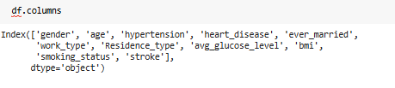
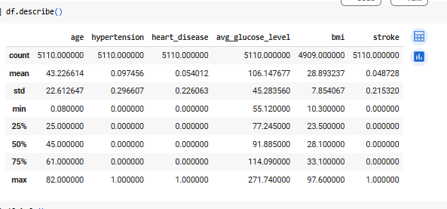
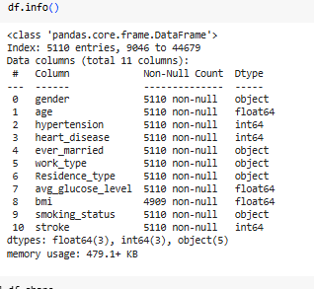

Slide 10
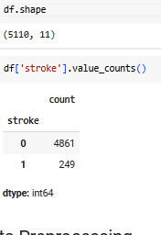
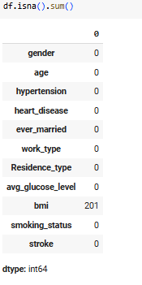
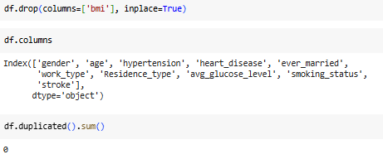

Slide 11
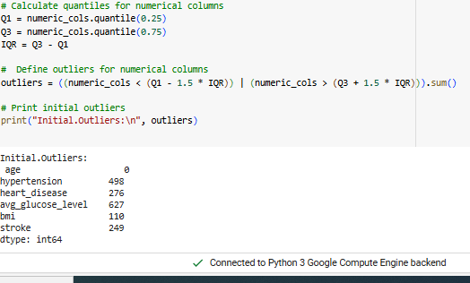
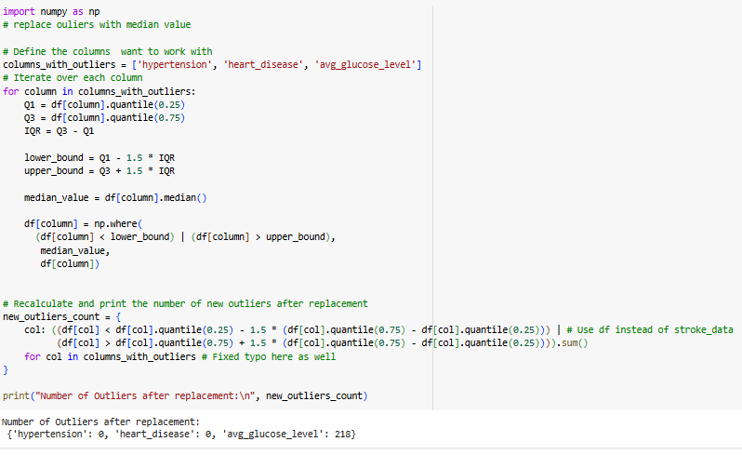

Slide 12
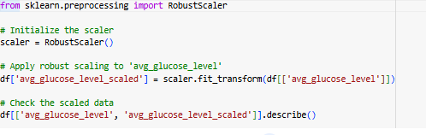
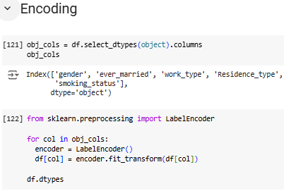
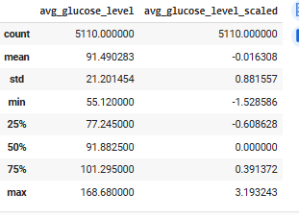
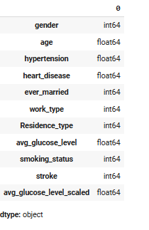

Slide 13
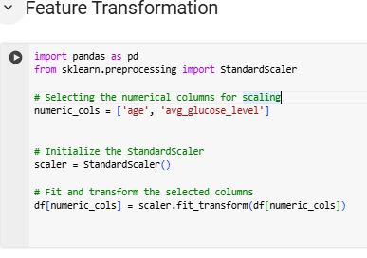
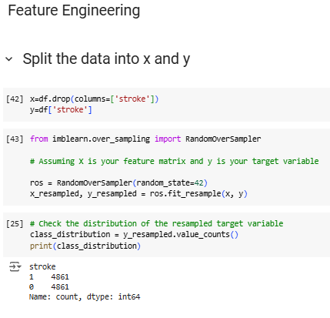
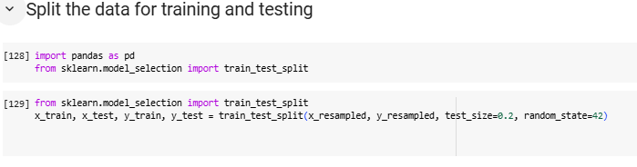

Slide 14
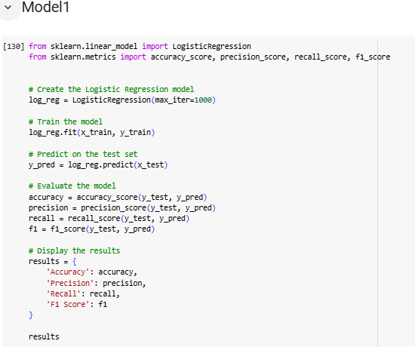


Slide 15
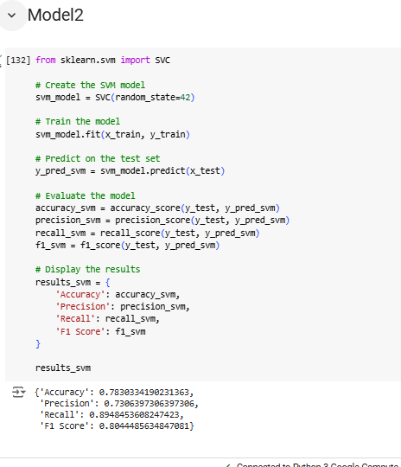

Slide 16
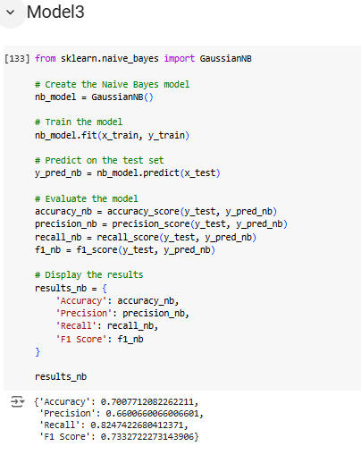

Slide 17
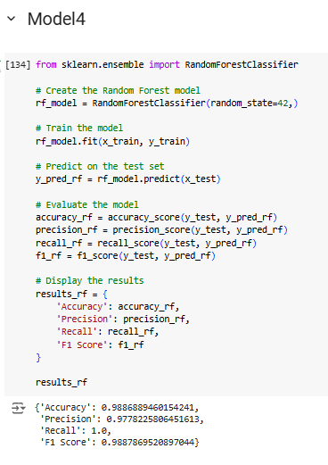

Slide 18
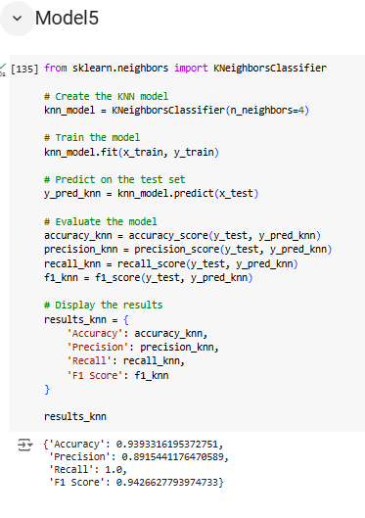

Slide 19
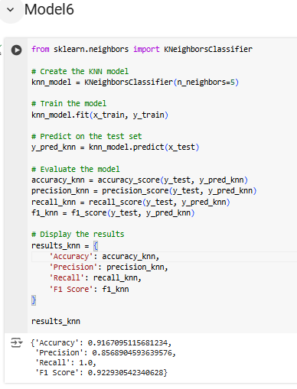

Slide 20
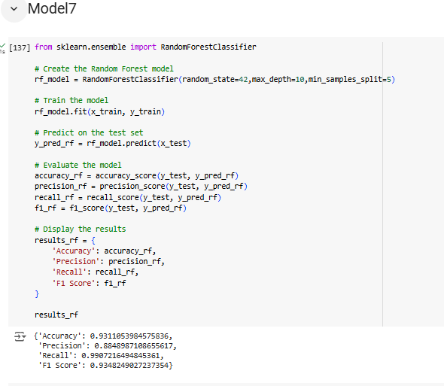

Slide 21
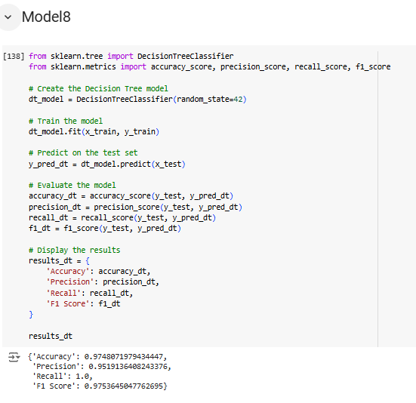

Slide 22
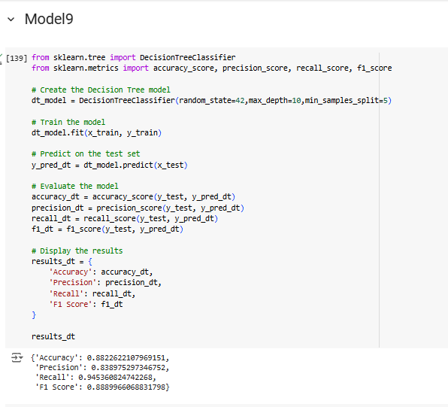

Slide 23
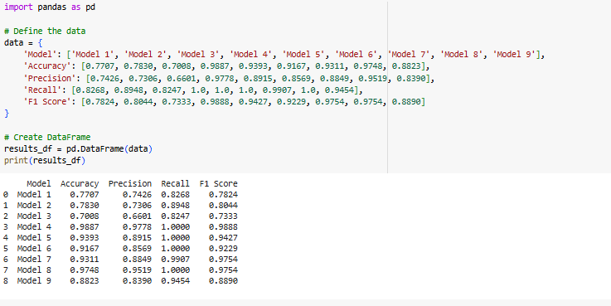

Slide 24
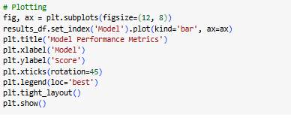
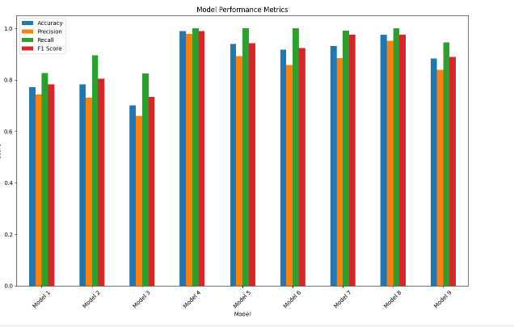

Slide 25
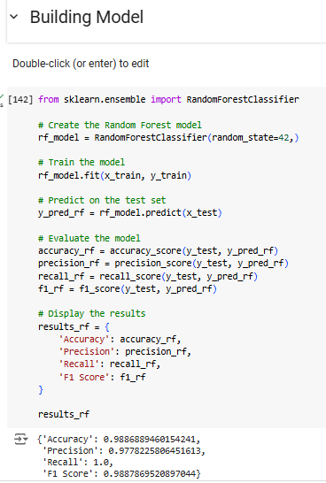

Slide 26
CONCLUSION
Model 4 was selected as the final predictive model due to its superior performance across all evaluated metrics. Its high accuracy and perfect recall indicate that it effectively identifies all positive instances of stroke, making it a reliable tool for early intervention strategies in healthcare. Additionally, its high precision ensures minimal false positives, which is crucial for maintaining the quality of care and resource allocation.
In this advanced machine learning project, we aimed to predict stroke occurrences using a comprehensive healthcare dataset that includes demographic, health, and behavioral attributes. Our workflow included meticulous data preprocessing, feature engineering, and addressing class imbalance, followed by the selection and evaluation of multiple machine learning models.

